Slide 1
Overview of CSCW Participation Types and Review Process
David W. McDonald
The Information School
University of Washington
October 15, 2012
Notes:
Based on slides from Wendy Kellogg’s presentation for the paper writing workshop in China c.2010

Slide 2
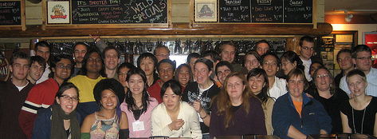
Types of Participation
Author a Paper/Note
Organize a Panel
Organize a Workshop
  Submit to a Workshop
Submit to the Doctoral Colloquium
  for PhD Students only
Volunteer
  Organizing Committee, Program Committee, Reviewing
Student Volunteer
Student Volunteers at Post-Conference Party

Slide 3
Submission Types
Papers/Notes
  4-6 “note”, 10 “paper”
Interactive Papers/Posters
  Extended abstract, poster, interactive poster session
Videos
Demonstrations
  Live, new tools, new systems
Doctoral Colloquium
  Extended abstract,
Workshops
  Topical, organizers set participation requirements, target 10-30 participants
Panels
  Set of short presentations and discussion, audience questions
Tutorials
  A course on a technique, topic, or method

Slide 4
Is my work a Paper or Note?
Papers
Notes
10 pages
Break new ground, novel intellectual/technical contribution
Provide complete and substantial support for results and conclusions
Represent a major advance for the field of CSCW/HCI
4 pages
Same scientific standards
Smaller scope and scale
Limited discussion of related work
Examples:
  New domain, possibly same results
  A novel system without full evaluation or implementation details

Slide 5
Papers at CSCW
Distinction between “Paper” and “Note”
  Broadly in the CHI/HCI community
    Note implies ~ 4 page archival research contribution
    Paper implies ~ 10 page archival research contribution
CSCW 2013 Removed the distinction
  A “paper” is as long/short as it needs to be
Novel, original, unpublished, finished & mature work
Significant, critical, peer review
Publications archived in the ACM Digital Library

Slide 6
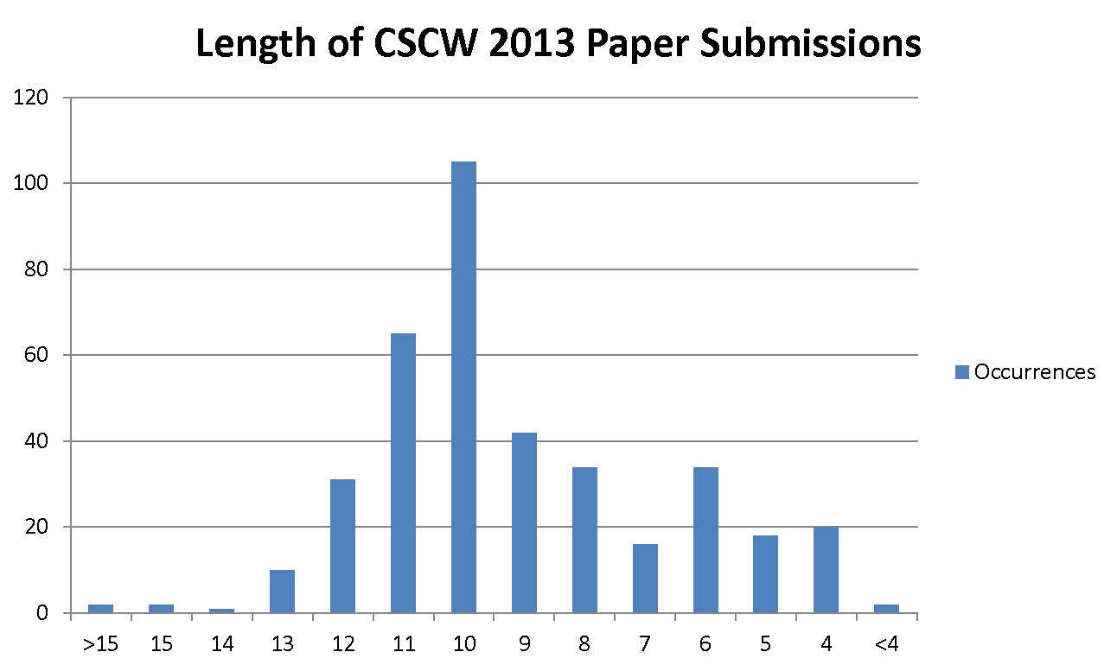
CSCW 2013 Paper Length
Most CSCW submissions are about 10 pages

Slide 7
CSCW Topics and Approaches
Technical
  System Design
  Emerging Technologies
  Systems to Support Cooperative Work in Specific Domains
Behavioral
  Qualitative Empirical Studies
  Quantitative Empirical Studies
  Cross-Boundary Work
  Use of Emerging Technologies
  Emerging Cooperative Phenomena
  Studies of Cooperative Work in Specific Domains
Methodological/Theoretical
  Theories & Models
  Methodologies & Tools

Slide 8
CSCW Domains
Collaboration and collaborative systems for:
  Social computing, social media
  Social networks
  User generated content
  Healthcare
  Gaming (for enjoyment or work)
  Crowdsourcing, Collective intelligence
  ICT4D (Information and Communication Technologies for Development)
  Work, work place, governance, decision making, transportation, emergency response, sustainability, etc
Collaboration systems using emerging technologies:
  Mobile and ubiquitous computing
  Game engines
  Virtual worlds
  Sensor-based environments.

Slide 9
Approximate CSCW Deadlines
Papers
Workshop Proposals
Tutorials
Due late May of prior year
Doctoral Colloquium
Panels
Due October of prior year
Demonstrations
Videos
Interactive Papers/Posters
Workshop Participation
Due November of prior year

Slide 10
CSCW Reviewing Process

Slide 11
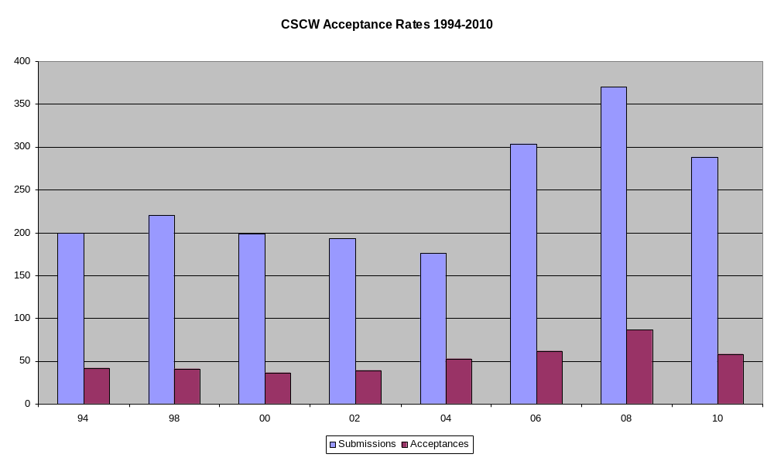
The Bad News
Most CSCW submissions are rejected!
Notes:
The workshop presenters probably have nearly as many rejections in CSCW as we do acceptances!
In these charts the acceptance rates vary, but historically they have been between 20-24%

Slide 12
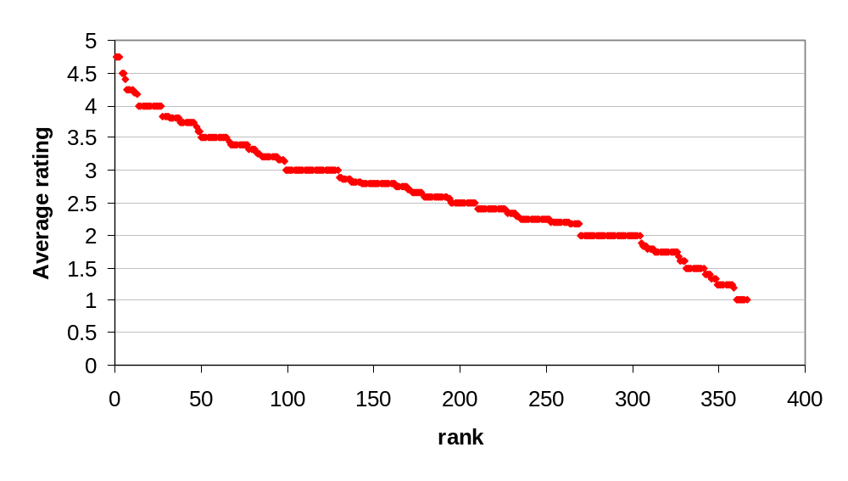
Typical Raw Score Distribution
Notes:
I believe this is the CSCW 2008 distribution, it’s the only one so far with over 350 submissions?

Slide 13
Difference at a Glance
CSCW
CHI
Two rounds of reviewing
  Revise and resubmit
  About 50% invited to revise
Decisions based on revisions, reviews of revised manuscript
One round of reviewing
  Authors write a rebuttal based on reviews
Decisions based on reviews of initial manuscript and rebuttal

Slide 14
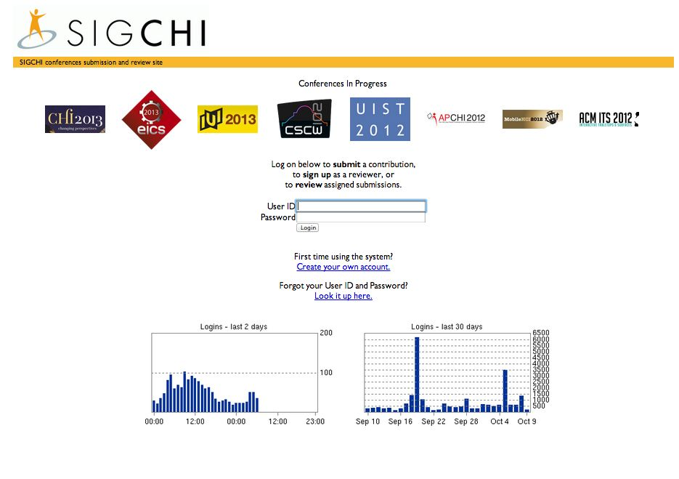
Conference Program & Review Management - PCS
http://precisionconference.com/~sigchi/

Slide 15
CSCW Program Committee
Papers Co-Chairs
  2 Internationally recognized experts in CSCW
Associate Chair (ACs)
  ~35, diversity of topics and experience
  Each AC is assigned 4-6 papers as “Primary AC”
    Primary AC assigns 1 external reviewer
  Each AC is assigned 4-6 papers as “Secondary AC”
    Secondary AC assigns 1 external reviewer
    Secondary AC conducts a full review (like an external)
Reviewers
Notes:
For CHI the Program Committee structure is similar, but much much larger.
As well, in CHI the program committee is broken into a number of broad topical sub-committees.

Slide 16
CSCW Review Timeline
Prepare Submission
Submit Paper
  ACs assigned, reviewers assigned
First Round Reviewing
t = -6 months to -1 year
t = 0
t = 1.5 months

Slide 17
Common Review Criteria
Most reviewers will look to answer:
  Does this paper address a CSCW topic?
  Have the authors given a useful discussion of related work?
    Have they positioned their work with respect to the literature?
  Have the authors used appropriate methods?
  Have the authors made a contribution to the field (technical, behavioral, methodological)?
  Is the paper appropriate length for the size of contribution?
  Are the results scientifically sound?
    Can other researchers take them up with confidence and build on them?
  What can the community as a whole learn from the results?
  Is the paper well written, with a clear problem statement, approach, results, discussion, and conclusion?

Slide 18
First Round Results
About 50% will receive a “Revise and Resubmit”
  About 50% will be rejected
Reviews include
  3 individual reviews, 1 summary ‘meta-review’
  Meta-review is by the assigned Associate Chair (AC)
Generally need a mean score in 2.5 to 3.0 range

Slide 19
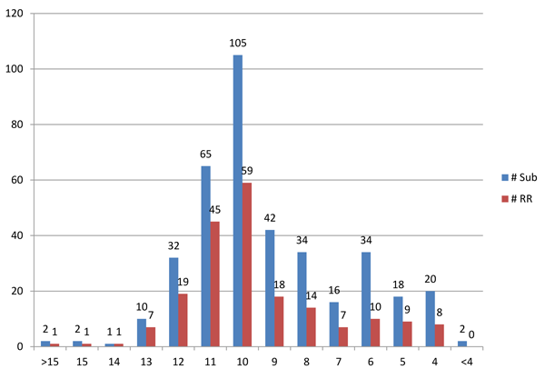
CSCW 2013 Revise and Resubmit per Length
Shorter papers tend to have lower revise and resubmit rate.

Slide 20
CSCW Review Timeline
Prepare Submission
Submit Paper
First Round Reviewing
Revise Paper & Resubmit
t = -6 months to -1 year
t = 0
t = 1.5 months
t = 2.5 months

Slide 21
Your Revision
Read all reviews completely
  CSCW reviewers have been particularly helpful in the last two years
  Reviews will identify problems, some will suggest different directions to fix knowing there is 1 month to improve the paper.
Prioritize fixes/revision of your paper
  Meta-review identifies most significant criticisms and tries to place them in context
  Address additional issues from reviewers
  Fix all grammatical, formatting issues raised

Slide 22
Your Revision
Revision Summary
  Provide a high level overview of the revisions you made
  Detail comments on each issue addressed from the reviews
  Elaborate or explain a detail that may have been missed by a specific reviewer
Resubmit new version

Slide 23
CSCW Review Timeline
Prepare Submission
Submit Paper
First Round Reviewing
Revise Paper & Resubmit
Second Round Reviewing
t = -6 months to -1 year
t = 0
t = 1.5 months
t = 2.5 months
t = 3.5 months

Slide 24
Second Round Re-Review
Full re-review of new version
  Same Associate Chair
  Same set of reviewers
Same review criteria
  Reviewers read the Revision Summary, revised paper
  Reviewers will look for specific criticisms to be addressed
  Reviewers reassess the whole paper, not just the changes

Slide 25
CSCW Review Timeline
Prepare Submission
Submit Paper
First Round Reviewing
Revise Paper & Resubmit
Second Round Reviewing
Program Committee Meets
t = -6 months to -1 year
t = 0
t = 1.5 months
t = 2.5 months
t = 3.5 months
t = 4 months

Slide 26
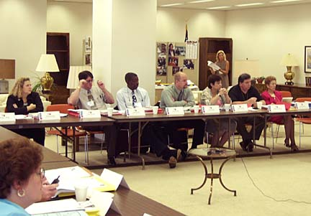
Program Committee
Face to face meeting of all ACs
Final decision making
  Revised paper, reviews, possible discussions among the reviewers
  Primary AC gives a short overview of paper topic, methods, overview of reviewer comments, and makes a recommendation
After meeting Papers co-chairs review and finalize recommendations

Slide 27
CSCW Review Timeline
Prepare Submission
Submit Paper
First Round Reviewing
Revise Paper & Resubmit
Second Round Reviewing
Program Committee Meets
Decisions Announced
Final Revisions Due
t = -6 months to -1 year
t = 0
t = 1.5 months
t = 2.5 months
t = 3.5 months
t = 4 months
t = 4 months
t = 5 months

Slide 28
Final Revisions
Authors receive second round reviews, meta-review and decision
Accepted papers, revise (again) based on reviews
Camera ready copy is due about 1 month after.

Slide 29
Getting Your Work Accepted at CSCW/CHI
Know the related literature (especially CSCW / ECSCW / CHI papers) intimately and how your work relates to it.
Tell a compelling story about your work.
  what problem it solves
  how it goes beyond what is already known
  what you built/observed/did
  limitations of your work, and
  what remains to be done.
Write your story well so that it communicates clearly and does not claim more than your results support.
Avoid common mistakes and pitfalls that will give reviewers or the committee a reason to rank your paper lower than other similarly-rated papers.

Slide 30
Summary: How to Get Your Paper Accepted at CSCW
The ACM CSCW conference is a leading forum for presenting and discussing research and development achievements concerning the use of computer technologies to support collaborative activities, as well as the impact of digital collaboration technologies on users, groups, organizations and society.

Slide 31
Questions/Discussion
Thanks for the invitation to come participate
  Cleidson de Souza (organizing the workshop)
Volunteer
  http://precisionconference.com/~sigchi/

